Slide 1


Accessibility: The Road to Success
February 19 – 21

Slide 2

Conference Schedule
February 19 12:00 PM | KEYNOTE: Accessibility: A Civil Right | Vance Martin , University of Illinois Springfield
February 19 2:00 PM | Mapping Your Success: Universal Design for Learning | Zach Petrea, Heartland Community College
February 20 10:00 AM | Simple Solutions: Accessibility for Audio and Video Resources | Robin Fisch, Sauk Valley Community College Lori Wendt, Parkland College
February 20 2:00 PM | Moving Down the Road to Success: How to Approach Accessibility | Kona Jones, Richland Community College Scott Rial, College of Lake County Susan Nugent, Lake Land College
February 21 10:00 AM | Moving Down the Road to Success: How Different Learning Management Systems Address Accessibility | Kona Jones, Richland Community College Selom Assignon, Harold Washington College Lara Tompkins, College of DuPage
February 21 2:00 PM | Digital Access and YOU | Becky Benkert & Mike Maxse, College of DuPage

Slide 3
Conference Archives
Recordings of these presentations will be available at:
http://www.ilcco.net/
under Resources & Events
For more information about ILCCO:
jeff.newell@illinois.gov

Slide 4
Moving Down the Road to Success: How Different Learning Management Systems Address Accessibility

Slide 5

Presenters
Kona Jones (Canvas)
Director Online Learning
Richland Community College
Dr. Selom Assignon (Brightspace)
Instructional Design Manager
Harold Washington College
Lara Tompkins (Blackboard)
Instructional Technologist
College of DuPage

Slide 6

Kona Jones I Director Online Learning I Richland Community College

Slide 7
Overall Accessibility
Canvas provides a Voluntary Product Accessibility Template (VPAT)
This VPAT is a tool that administrators and decision-makers can use to evaluate Canvas' conformance with the accessibility standards under Section 508 of the Rehabilitation Act and the Act WCAG 2.0 AA Standards.
WebAIM.org, a third party authority in web accessibility, has evaluated the Canvas Learning Management System (LMS) by Instructure and certifies it to be substantially conformant with Level A and Level AA of the Web Content Accessibility Guidelines version 2.0. [September, 2017]
https://www.canvaslms.com/accessibility

Slide 8
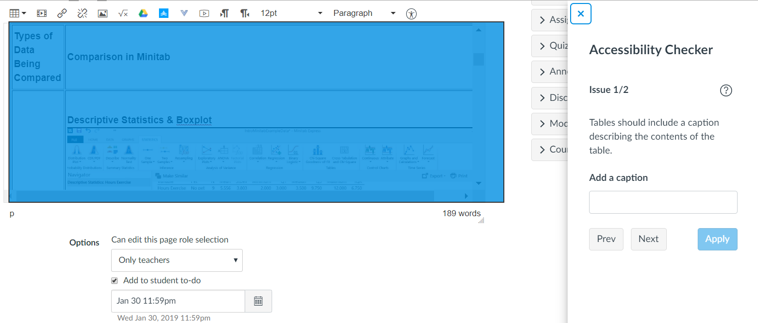
Canvas Accessibility Checker
*Only verifies content created within the Rich Content Editor

Slide 9
Canvas Accessibility Checker
Verifies the following:
Table captions
Table header scope
Table header
Sequential heading
Heading paragraphs
Image alt text
Image alt filename
Image alt length
Adjacent links
Large text contrast
Small text contrast

Slide 10
Accessibility Checker
  Access the Rich Content Editor
  Click the Checker Icon
  Box pops up letting you know how many issues you need to fix
  Guides you through how to fix the issues.

Slide 11

Enables faculty to identify accessibility issues in their Canvas course content.
It will scan a course, generate a report, and provide resources on how to address common accessibility issues.
Not built into Canvas, but is open source from Center for Distributed Learning (CDL) at the University of Central Florida (CDL).

Slide 12
Will identify “errors” and provide “suggestions” in the following areas of your course:
Announcements
Assignments
Discussions
Files (i.e., .html files)
Pages
Syllabus
Module URLs
It will check for the appropriate use of the following:
Use of headings in page structure
Alternative text for images
Table headers
Color contrast
Descriptive link text
Video captions

Slide 13

Audio & Video solution
  Easily create and upload video
  Can edit video
  Can embed quiz questions
  Students can comment on video
  Analytics
  High quality auto captioning
  Students can use to create video
  Integrates directly with Canvas

Slide 14
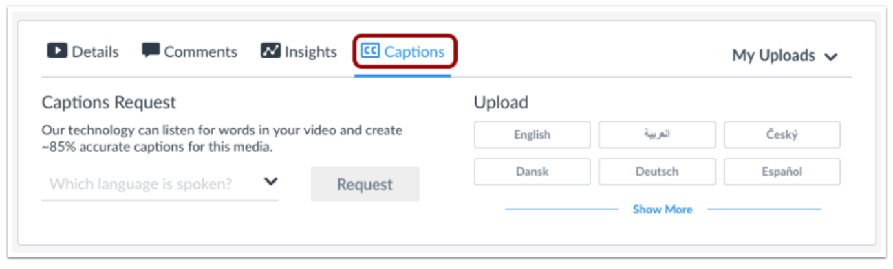
Easy auto-captioning

Slide 15
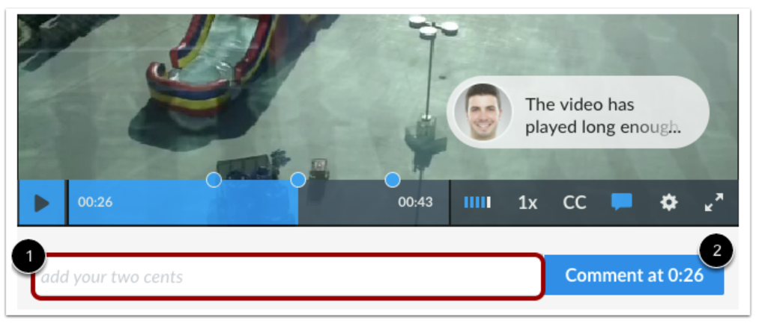
Add Comments

Slide 16
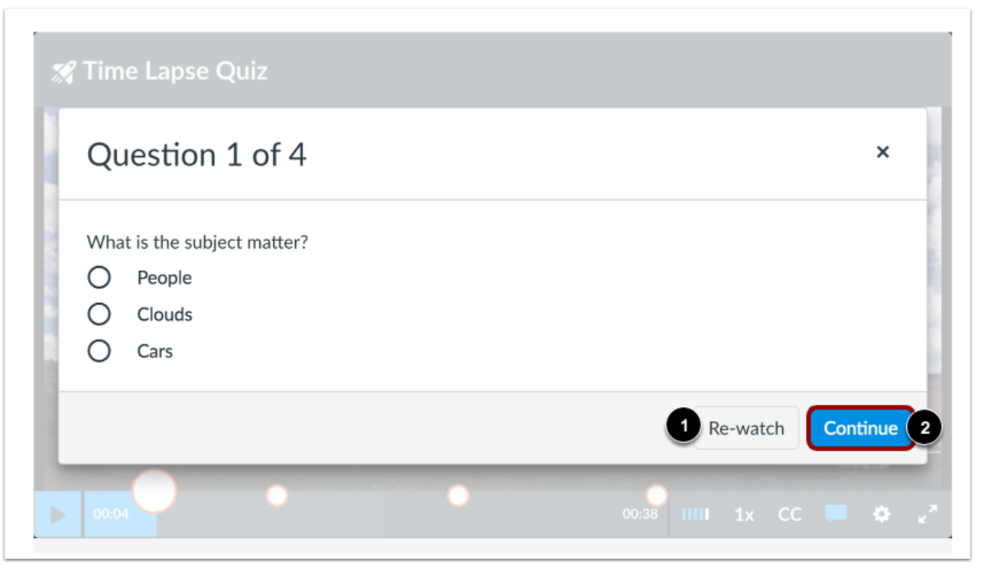
Quiz Questions

Slide 17
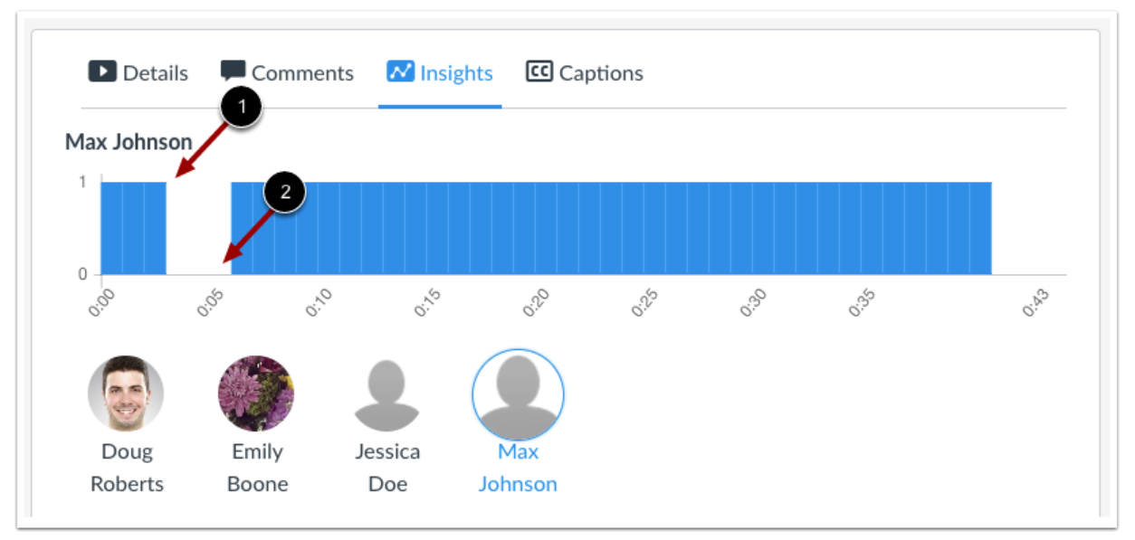
Analytics

Slide 18


Other potential Accessibility Tools
ALLY - http://ally.ac
Scans files and provides accessibility score
Scans other content added to the course
College wide accessibility analytics
Screencast-O-Matic - https://screencast-o-matic.com
Easy video creation and editing
Stores video
Integrates with Canvas
Add captions, extra for auto-captions

Slide 19
Lots of extra resources!
General Accessibility Design Guidelines - https://community.canvaslms.com/docs/DOC-2060-general-accessibility-design-guidelines
Accessibility within Canvas - https://community.canvaslms.com/docs/DOC-2061-accessibility-within-canvas
Accessibility Group in the Canvas Community - https://community.canvaslms.com/groups/accessibility/pages/accessibility

Slide 20

Dr. Selom Assignon I Instructional Design Manager I Harold Washington College

Slide 21
Overall Accessibility
Brightspace follows global accessibility standards for easy integration with assistive technologies.
Its design was done with accessibility compliance in mind and guided by WCAG 2.0 AA standards.
Openly report its compliance through VPAT and WCAG 2.0 AA checklists.
Notes:
VPAT (Voluntary Product Accessibility Template)
WCAG (Web Content Accessibility Checklist)

Slide 22
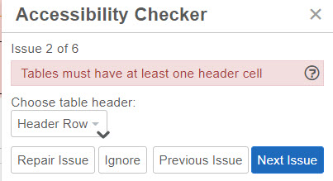

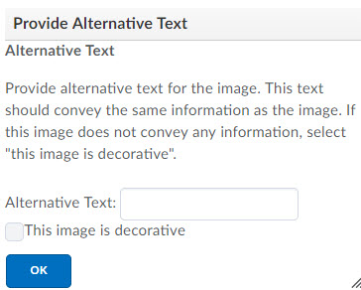
Accessibility Checker
  Built into the HTML editor
  Click the Checker Icon
  List all accessibility issues with a link on how to fix /repair them

Slide 23
Brightspace Accessibility Checker
Verifies the following:
Use of paragraphs as headings
Sequential headings
Adjacent links
Ordered list structure
Unordered list structure
Contrast ratio of text to background colors
Image ALT text
ALT text filename
Table Caption
Complex table summary
Table caption and summary
Table heading scope, markup, and headers

Slide 24
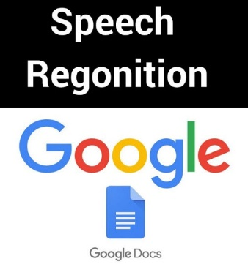


Free Tools to create accessible content
Audio / video transcription applications
  Google Docs Voice Typing tool

Slide 25
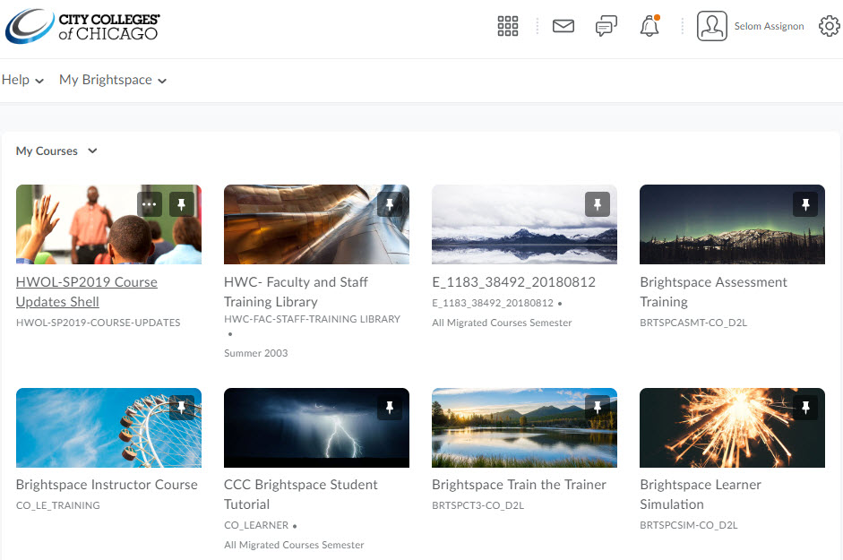
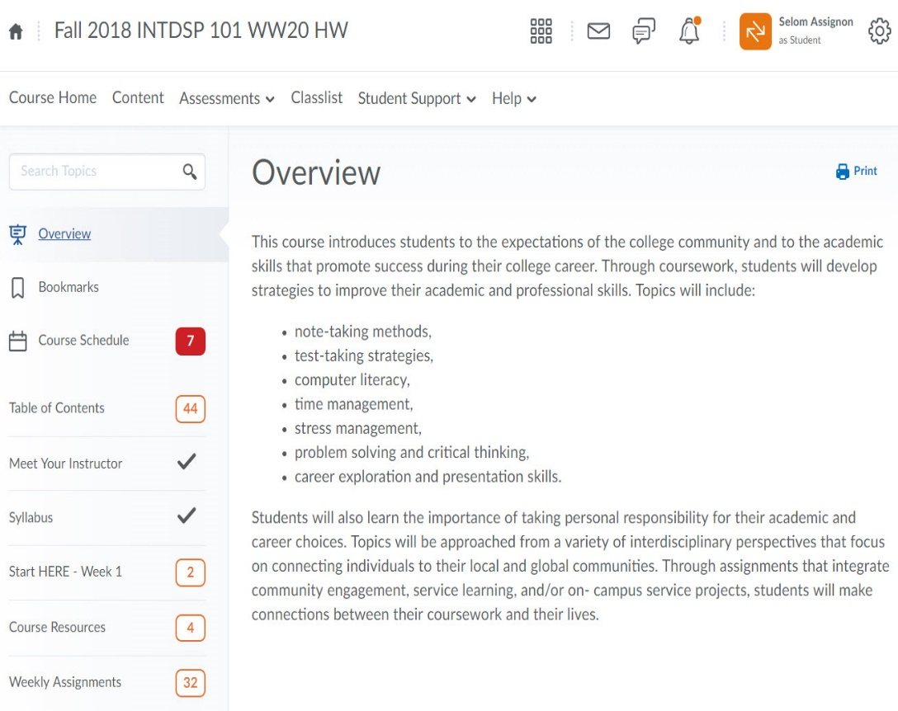
Brightspace Learning Environment

Slide 26
Additional Resources
https://community.brightspace.com/s/article/Brightspace-Accessibility-Checker
https://www.d2l.com/accessibility/
https://cloud.google.com/speech-to-text/
https://otranscribe.com/
https://www.voicea.com/
http://pave-pdf.org/index.en.html

Slide 27

Lara Tompkins I Instructional Technologist I College of DuPage

Slide 28
Blackboard’s Accessibility Compliance
Blackboard also has a VPAT and provides support documentation for users of assistive technology.
VPAT was done by Blackboard.
It has not been updated since the release of WCAG 2.1 last July.
Blackboard does not have any built-in accessibility features for instructors authoring content or students engaging with content.
Authoring practices do not have accessibility baked in.
t's difficult to edit the HTML of WYSIWYG content.

Slide 29

Blackboard Ally
Ally integrates into your LMS or CMS (Content Management System for your website) and provides different services based on a user's role in your institution. It was purchased by Blackboard in the fall of 2016.
  Administrators: The Administrative Report provides robust analytics on the state of accessibility at your institution for various stakeholders.
  Faculty and Staff: Course and term scoring and remediation.
  Students: Alternative formats that adapt to their unique contexts, preferences, and needs.

Slide 30

What Ally Checks
Ally checks the following content types against WCAG 2.0 in Blackboard (WCAG 2.1 support is in the works):
  PDF files
  Microsoft® Word files
  Microsoft® PowerPoint® files
  OpenOffice/LibreOffice files
  Uploaded HTML files
  Image files (JPG, JPEG, GIF, PNG, BPM, TIFF)
  YouTubeTM Videos
  WYSIWYG/VTBE content

Slide 31
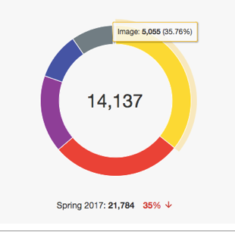
The Institution Report
Accessibility score over time
Total number of courses and content created by type
Accessibility issues and tons of filters

Slide 32
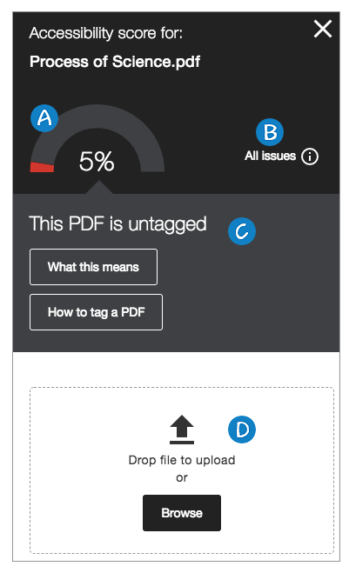
Guided Content Remediation
Content is scored as having a perfect, high, medium, or low accessibility level.
Dangerous content is flagged.
Explanation of the identified barriers and how they affect students.
Step-by-step remediation instructions for your authoring software.
Gradual, almost gamified, remediation workflow.

Slide 33
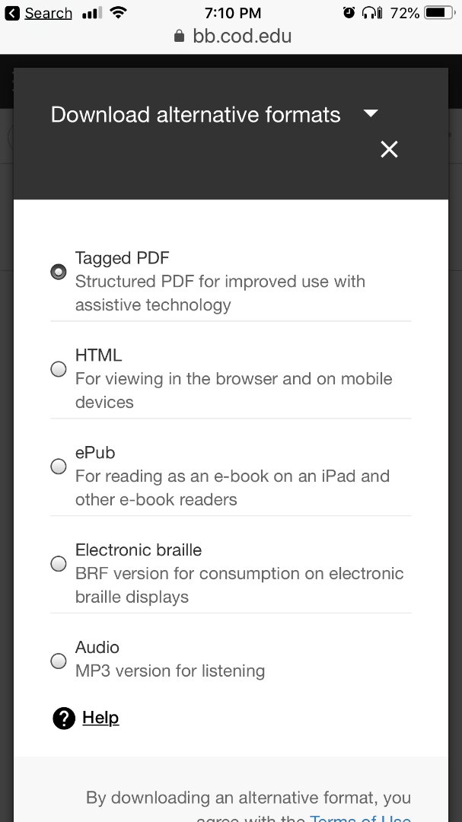
Alternative Formats 🙌
Formats Available:
  HTML
  Tagged PDF
  ePub
  Electronic Braille
  Audio mp3
Not available in the mobile apps
Is available on mobile web*
Alternative formats do not affect your original documents.
Generated alt formats do not live in your LMS instance.
Alt formats retain the copyright license of your original file.

Slide 34

Ally Resources
Documentation on the Blackboard Help site.
Handouts, fliers, surveys and more in the Adoption Toolkit.
On-site visit
Implementation Plan: Marketing and all the things and when to do them
  Pilot
  Roll Out
  Online User Group maintained by the original Ally team

Slide 35

They're Touring in a Groovy Vehicle!
Later this year, Ally will be visiting institutions across the US. Join the Ally User Group to learn more:
usergroup.ally.ac

Slide 36
Presenters
Kona Jones
Director Online Learning
Richland Community College
Dr. Selom Assignon
Instructional Design Manager
Harold Washington College
Lara Tompkins
Instructional Technologist
College of DuPage

Slide 37
Conference Schedule
February 19 12:00 PM | KEYNOTE: Accessibility: A Civil Right | Vance Martin , University of Illinois Springfield
February 19 2:00 PM | Mapping Your Success: Universal Design for Learning | Zach Petrea, Heartland Community College
February 20 10:00 AM | Simple Solutions: Accessibility for Audio and Video Resources | Robin Fisch, Sauk Valley Community College Lori Wendt, Parkland College
February 20 2:00 PM | Moving Down the Road to Success: How to Approach Accessibility | Kona Jones, Richland Community College Scott Rial, College of Lake County Susan Nugent, Lake Land College
February 21 10:00 AM | Moving Down the Road to Success: How Different Learning Management Systems Address Accessibility | Kona Jones, Richland Community College Selom Assignon, Harold Washington College Lara Tompkins, College of DuPage
February 21 2:00 PM | Digital Access and YOU | Becky Benkert & Mike Maxse, College of DuPage

Slide 38
Conference Archives
Recordings of these presentations will be available at:
http://www.ilcco.net/
under Resources & Events
For more information about ILCCO:
jeff.newell@illinois.gov

